Slide 1
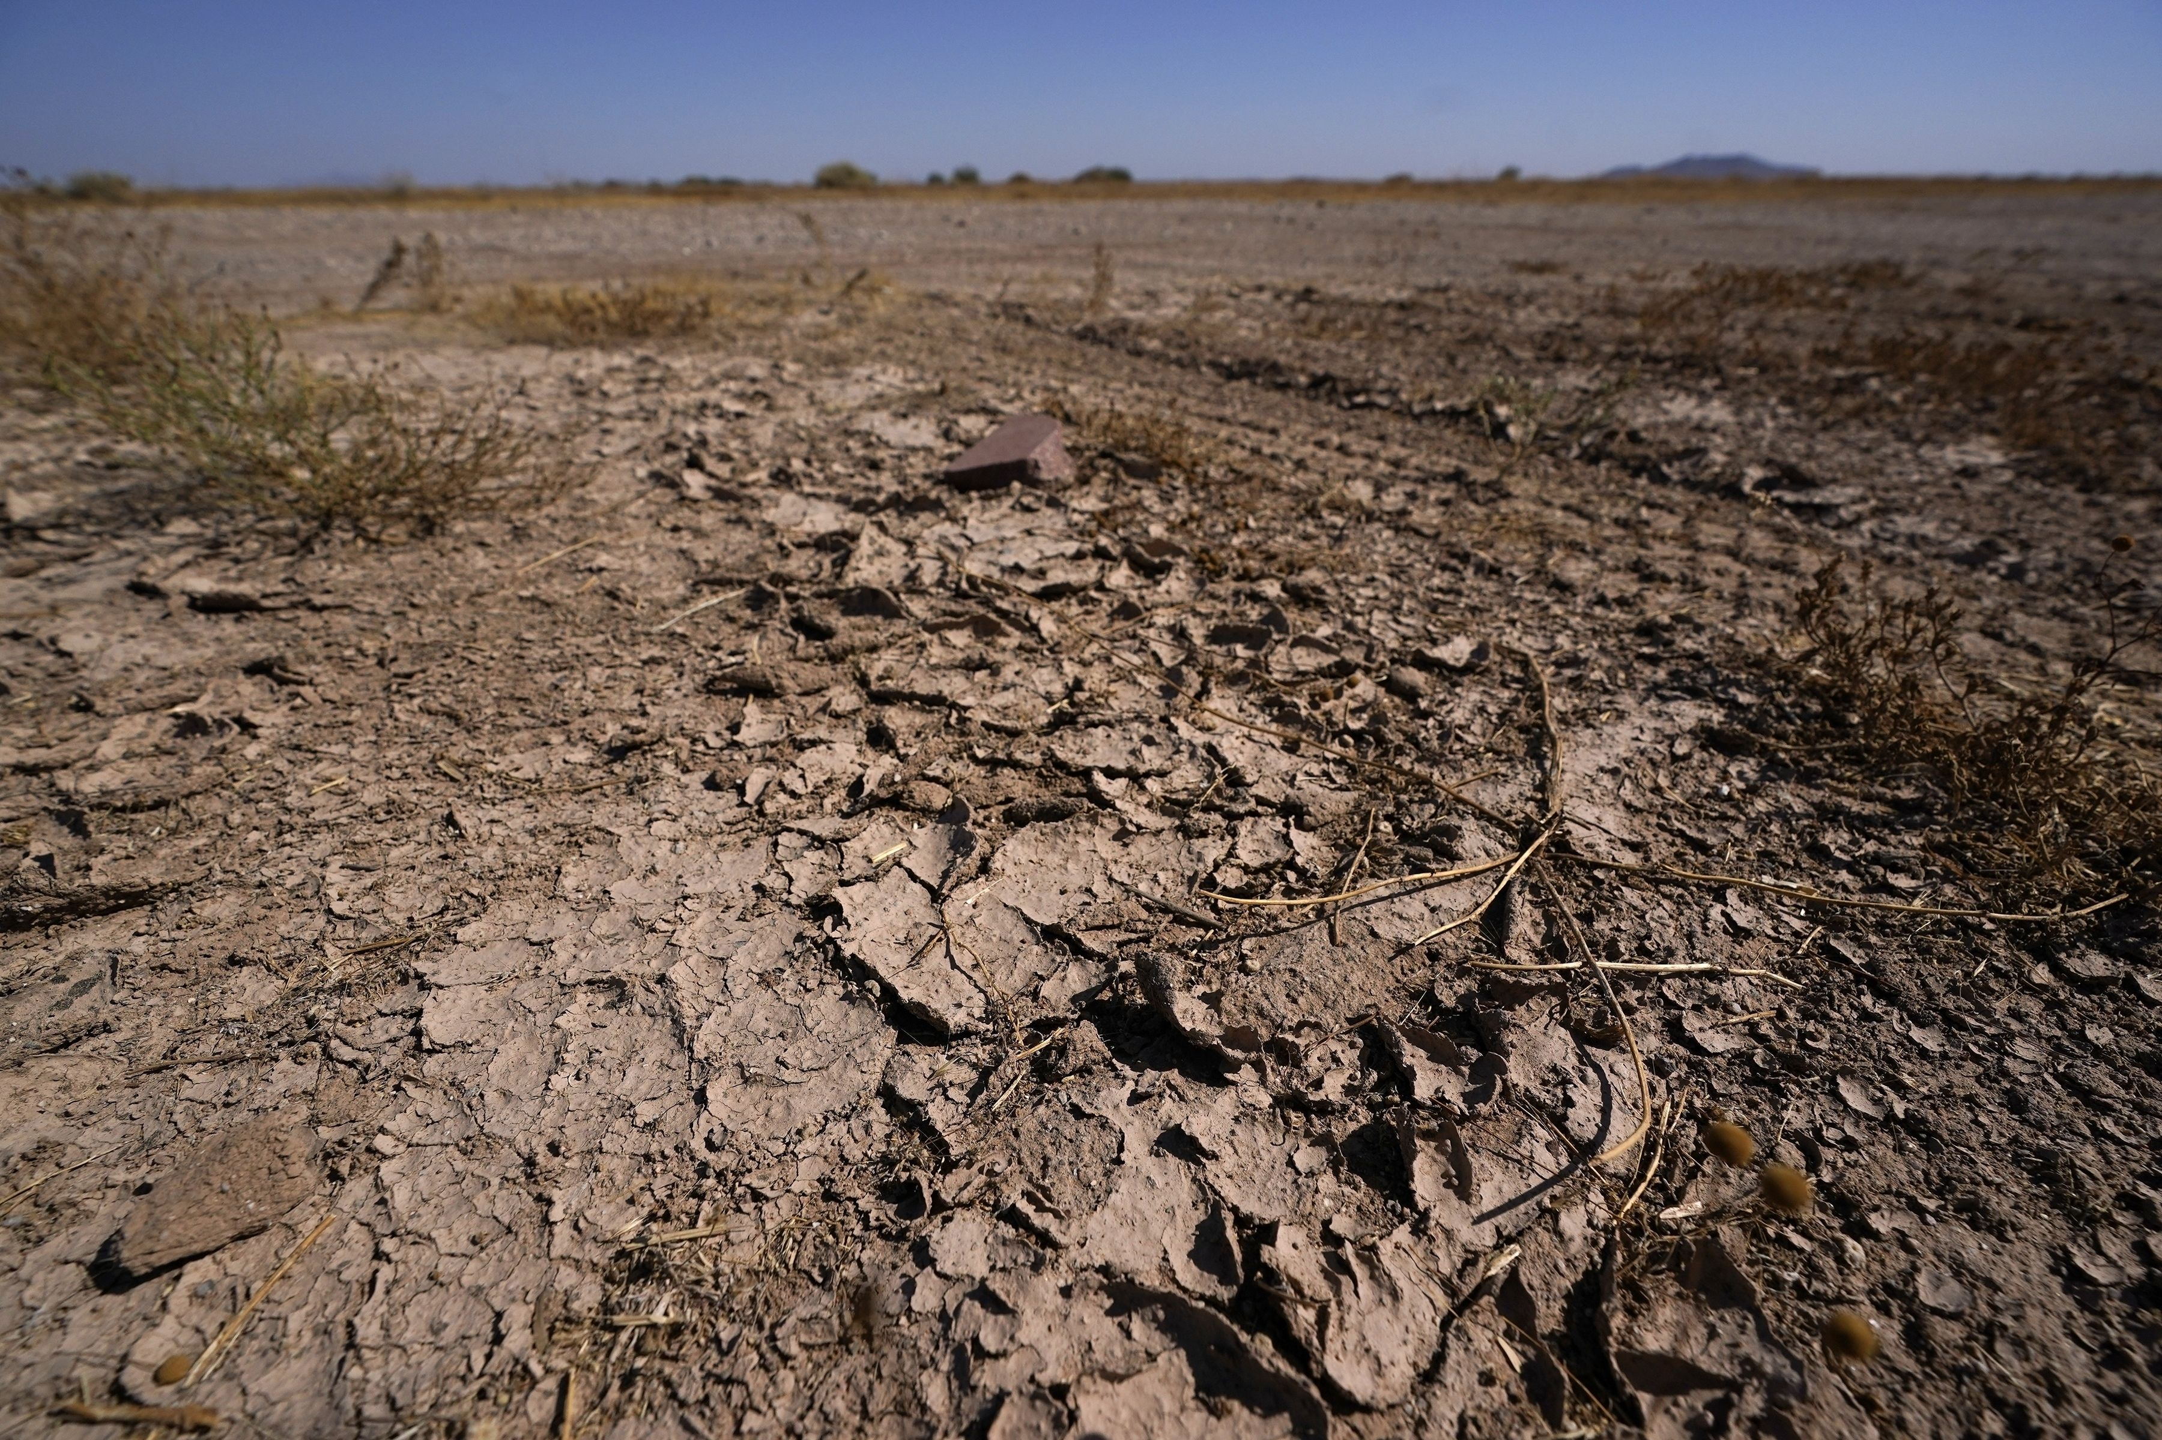
Developing a Flood and Drought Early Warning Network for the Upper Missouri River Basin
Seeking TCU Collaboration
Kyle Bocinsky
Director of Climate Extension
Montana Climate Office
University of Montana

Slide 2
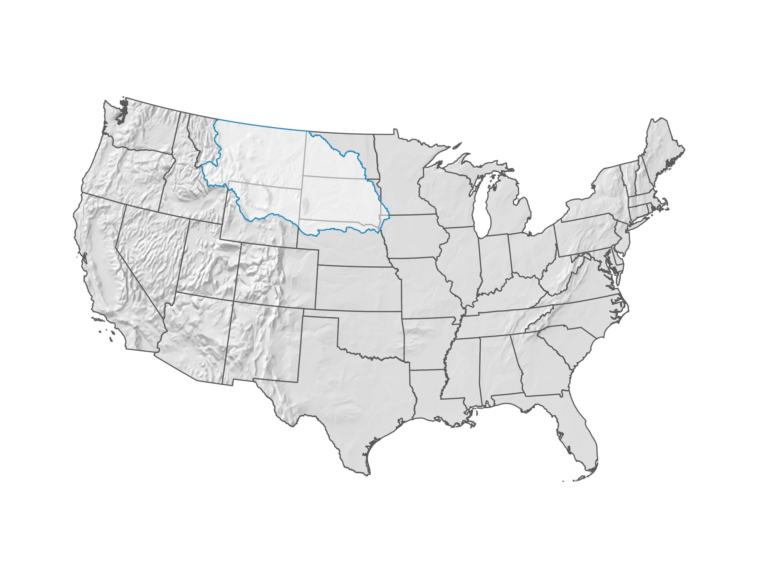
Upper Missouri River Basin

Slide 3
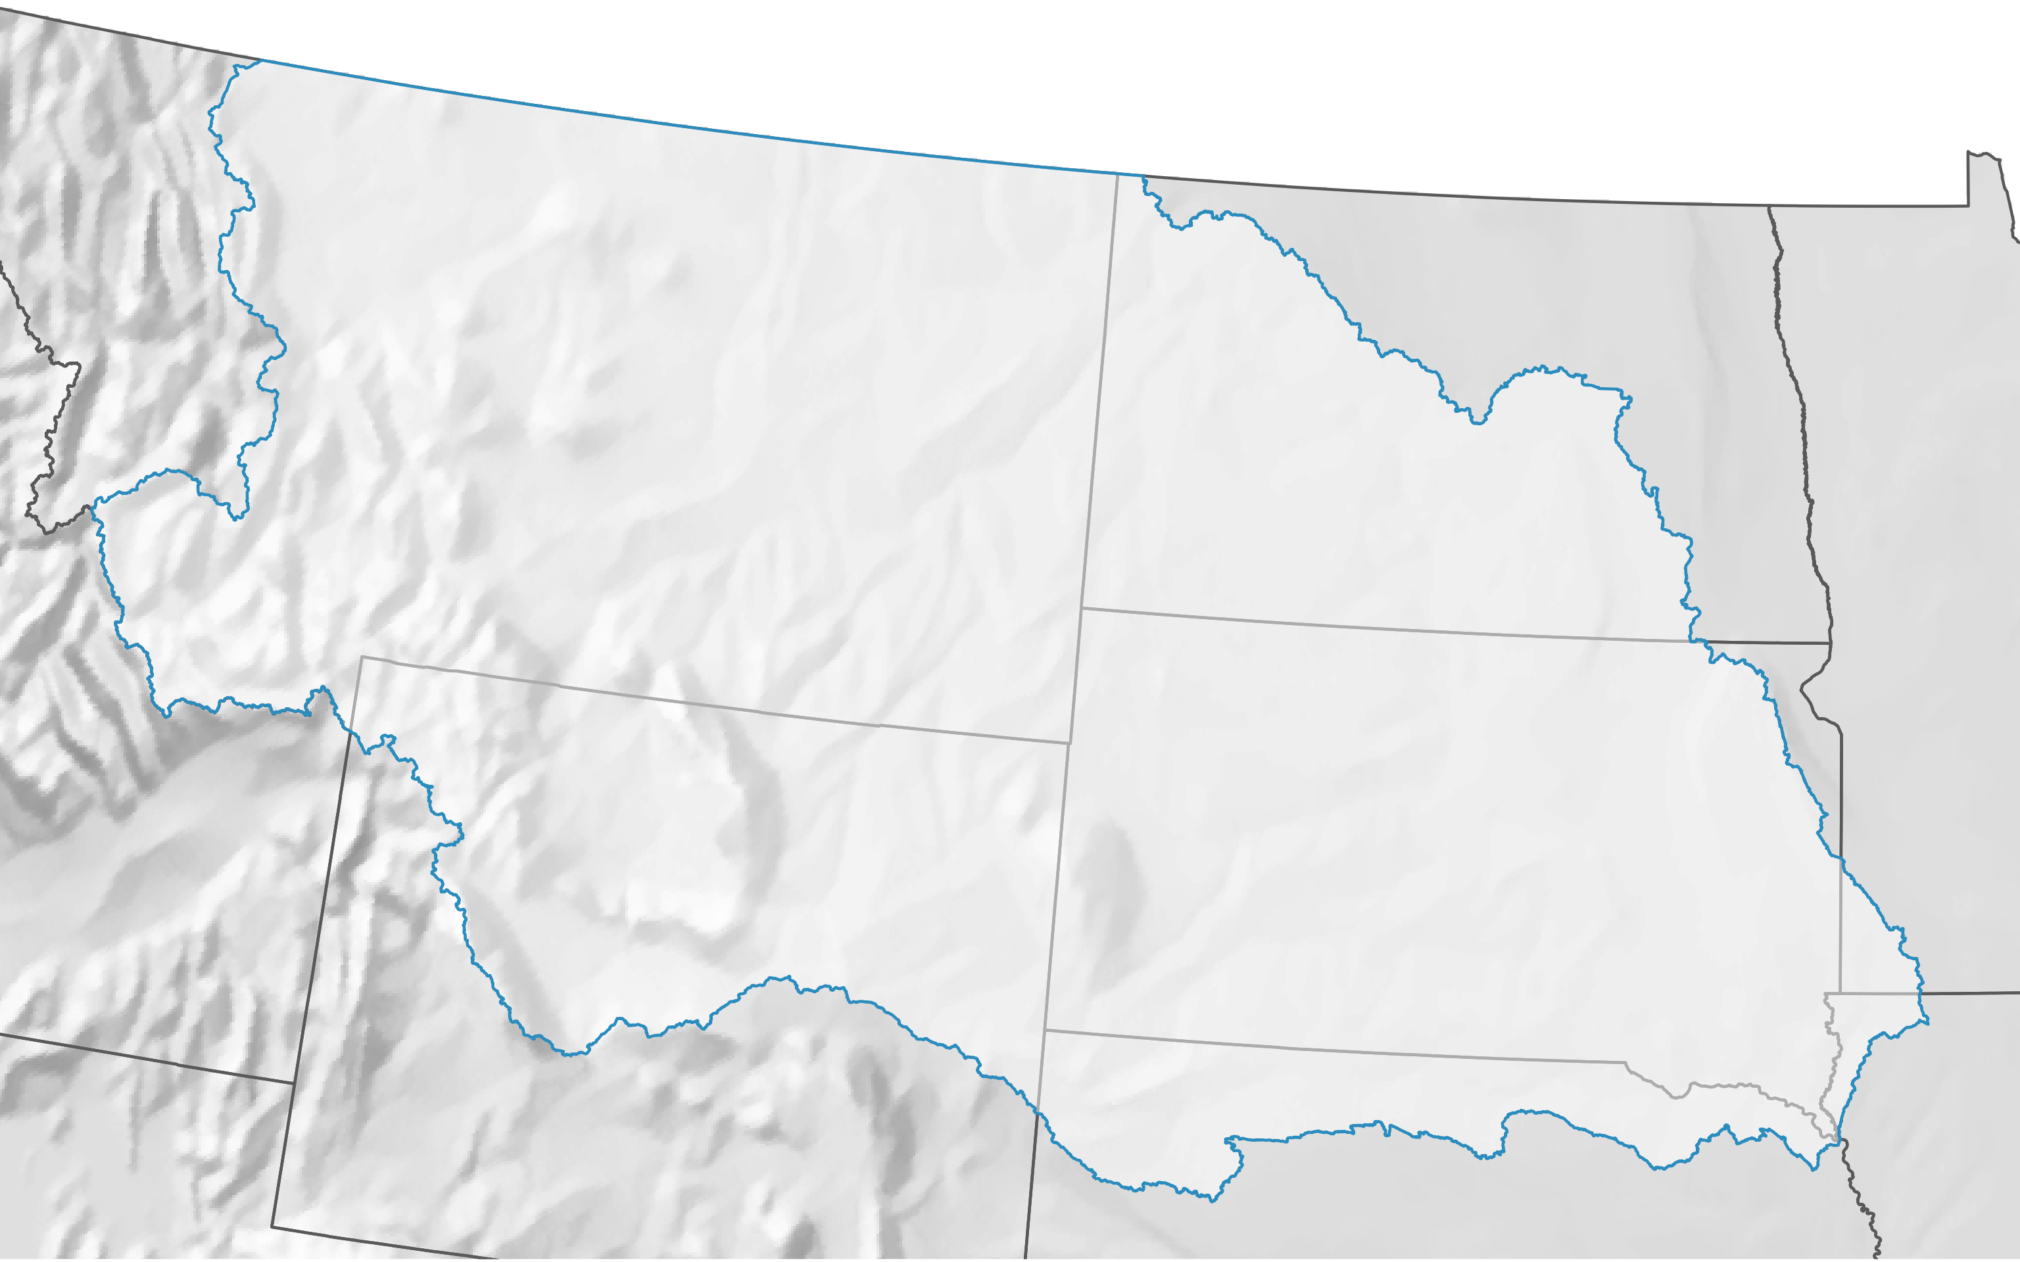
302,000 square miles
2,974,820 people (2020 Census)

Slide 4
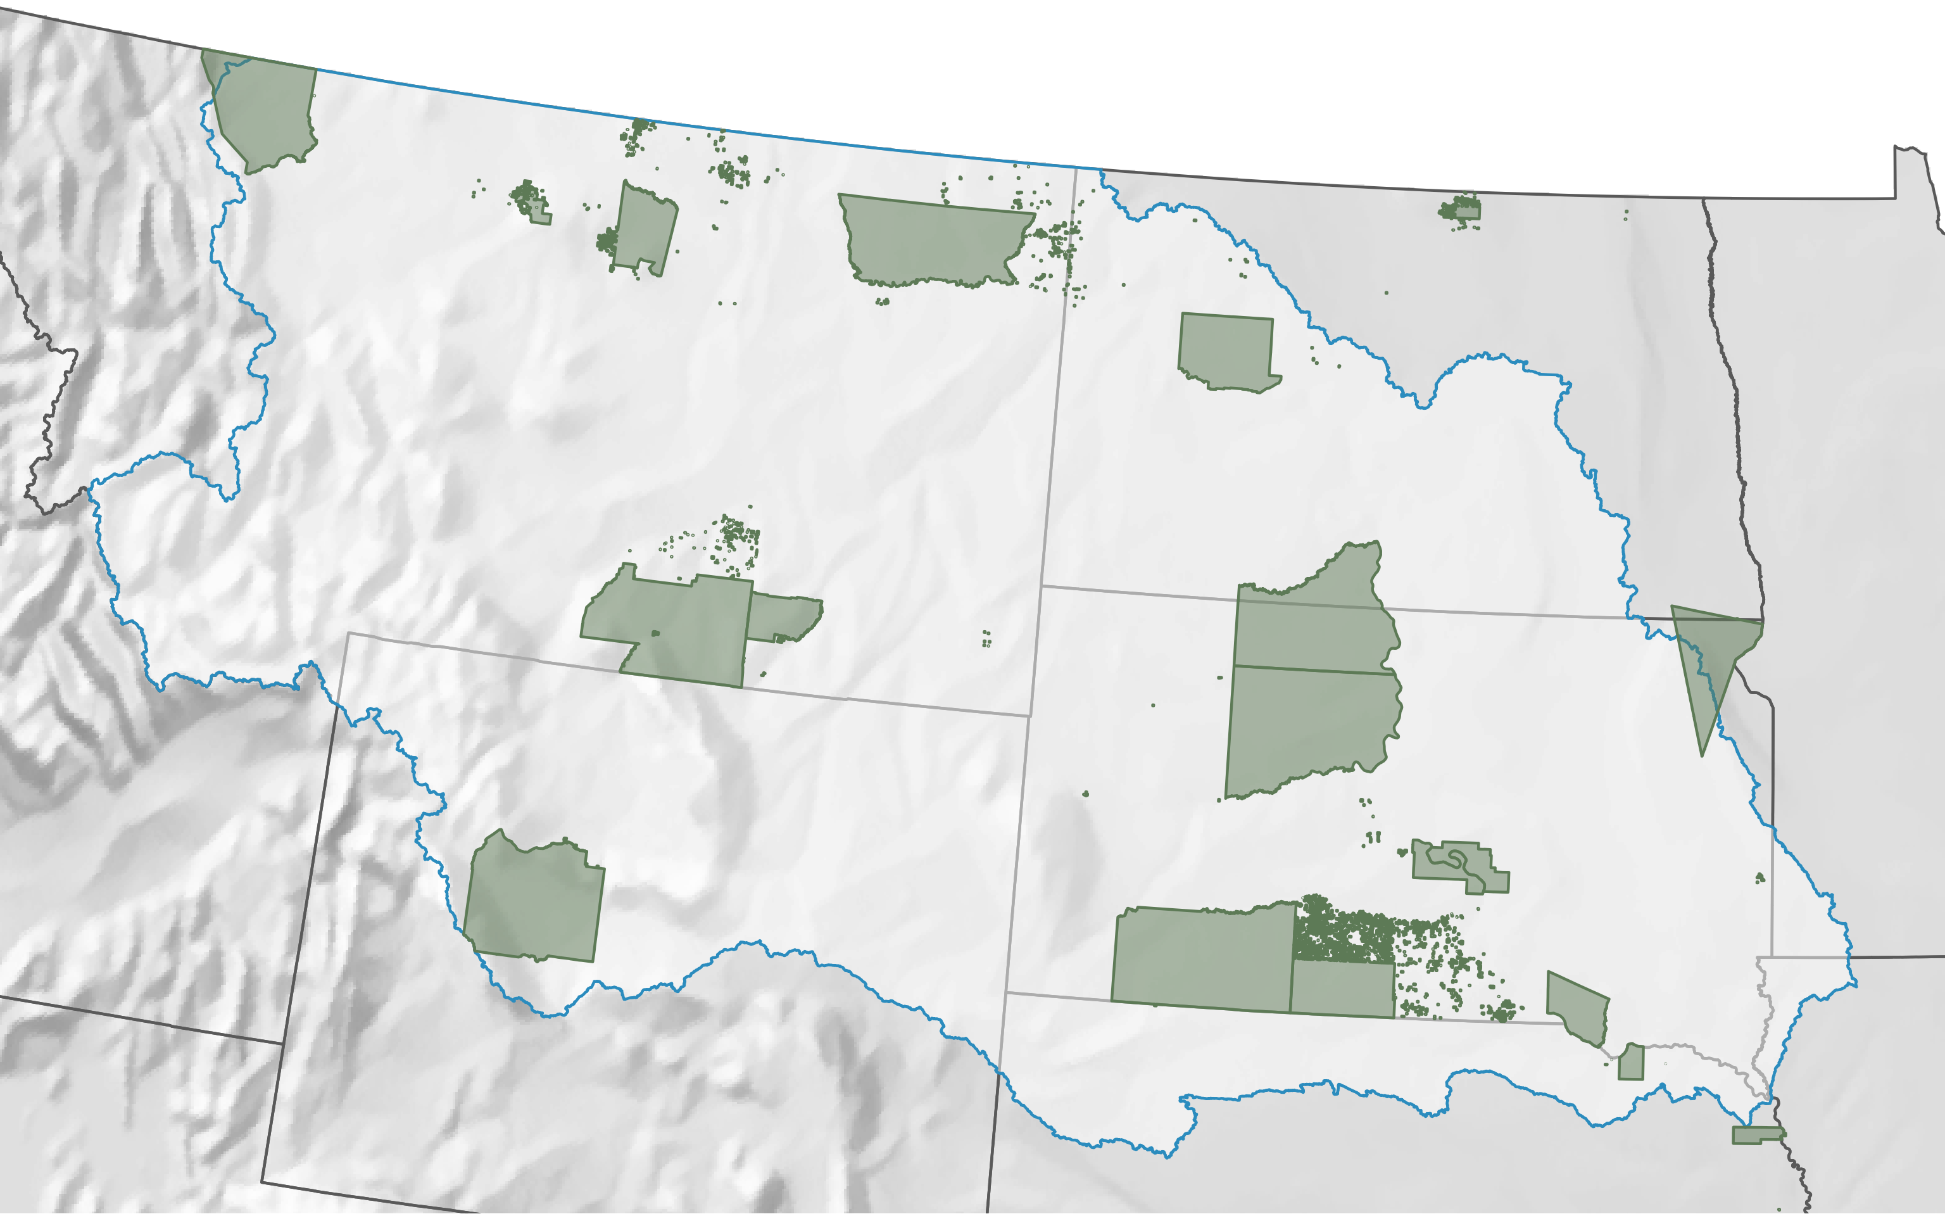
21 Tribal Reservations
145,802 Tribal residents

Slide 5
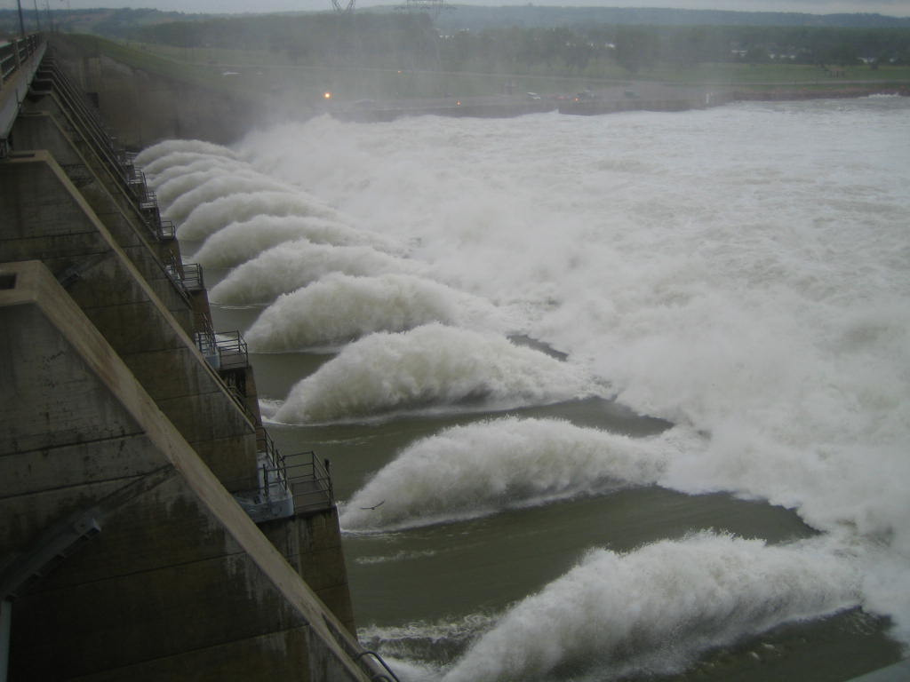

Slide 6
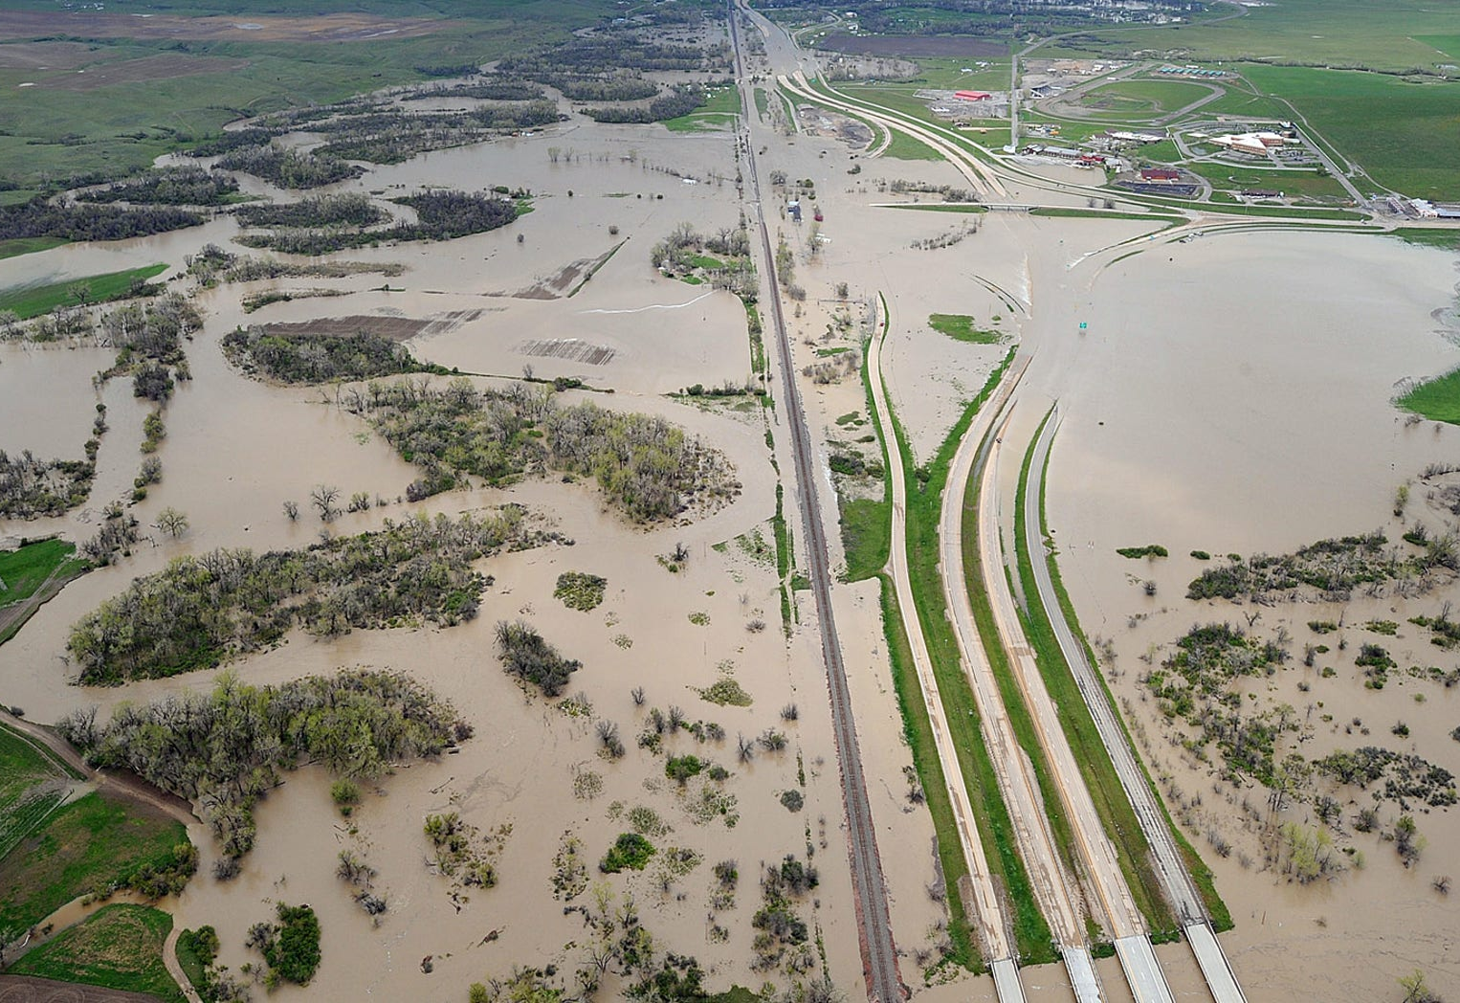

Slide 7
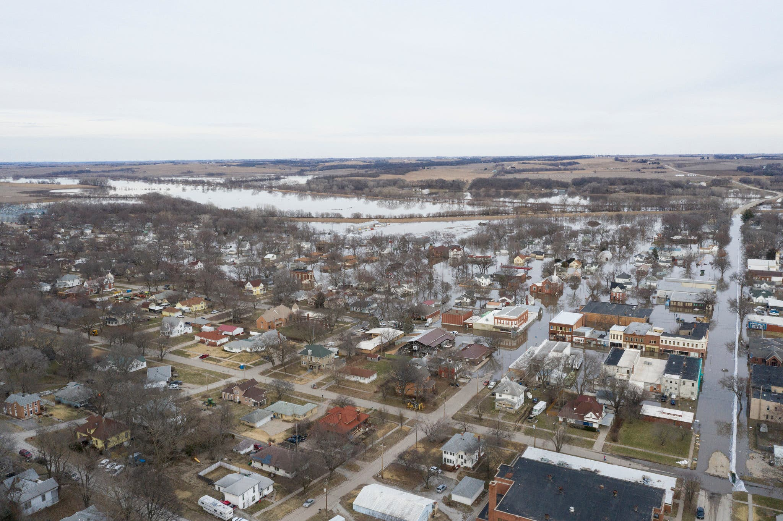

Slide 8
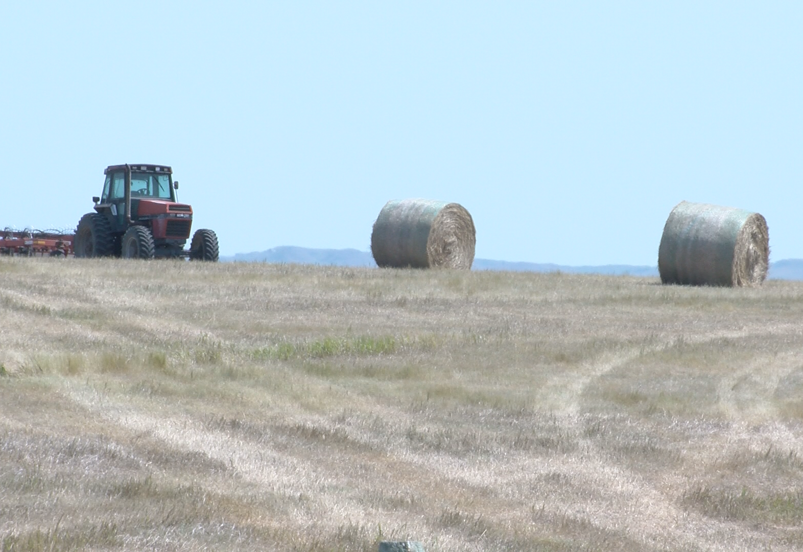

Slide 11
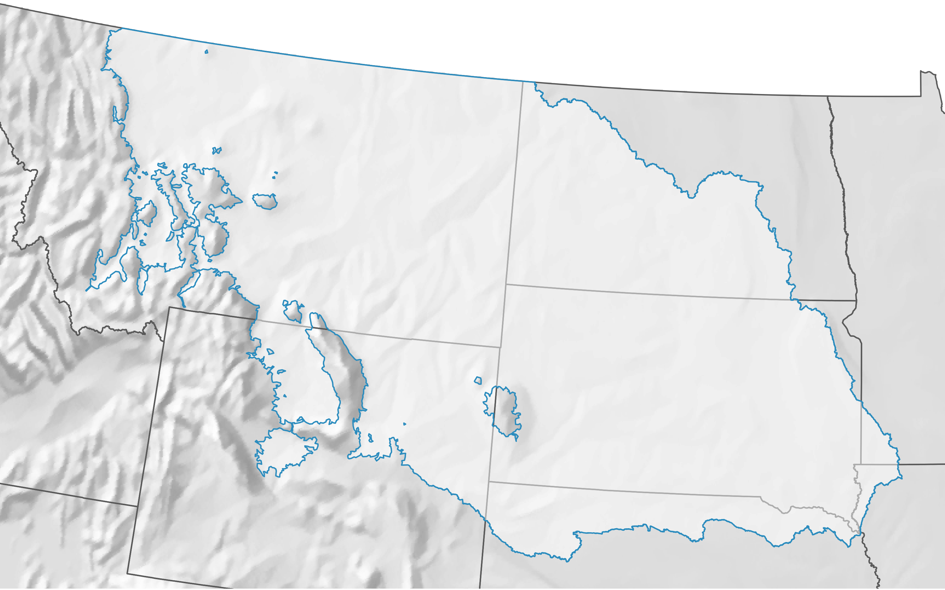
UMRB below 5,500 feet

Slide 12
500 square mile grid
540 grid squares

Slide 13
6 State Mesonets
MT: 205
ND: 79
WY: 61
SD: 156
IA: 4
NE: 35

Slide 14
500 square mile grid
540 grid squares

Slide 15
174 grid squares
include Tribal land

Slide 16
151 potential grid squares
to be filled on Tribal land

Slide 17
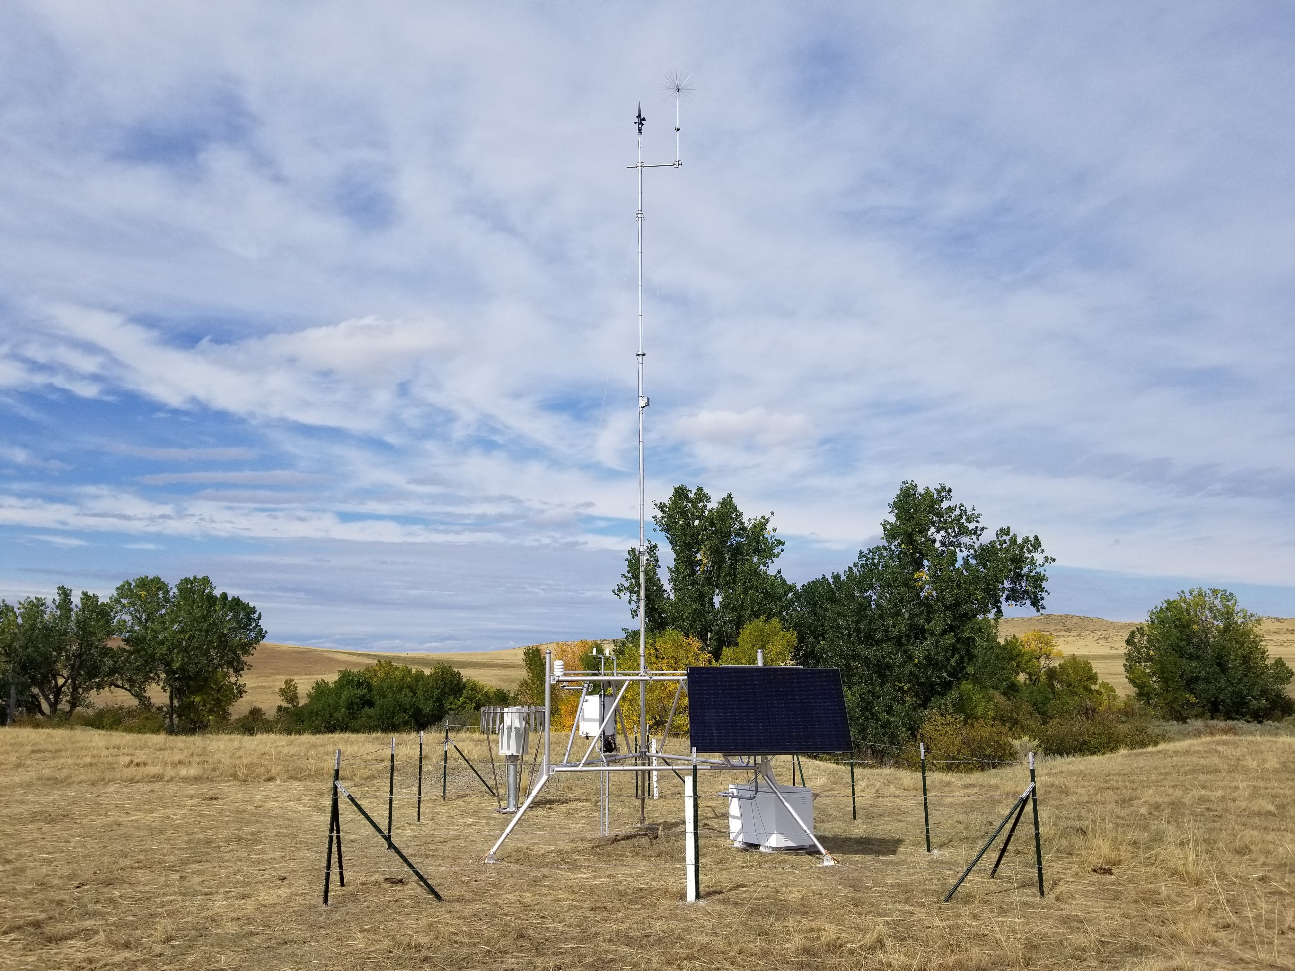

Slide 18
Wind Speed &
Direction
Temperature &
Relative Humidity
Solar Radiation
Precipitation
Solar Powered
Soil Moisture/Temperature
@ 2”, 4”, 8”, 20”, 40”
Snow Depth/SWE

Slide 19
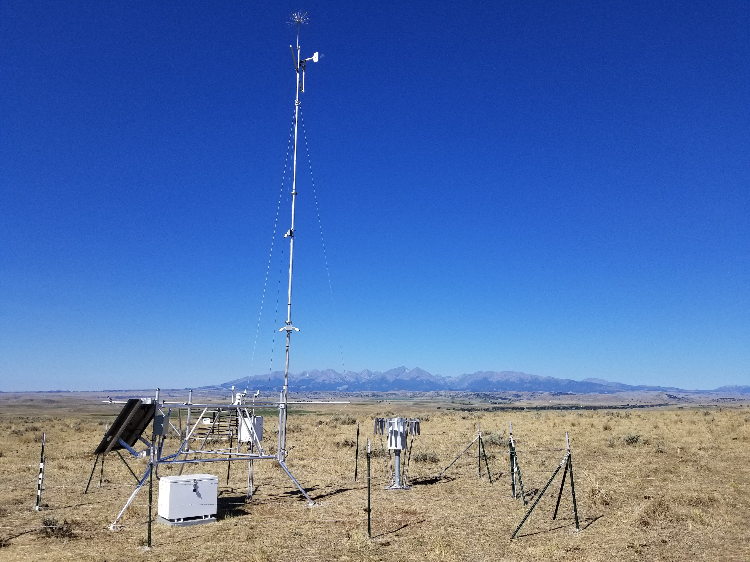
Seeking TCU Partnerships
Host a UMRB Soil Moisture station
Co-develop data displays for home communities
Mentorship and training for TCU students
Pathways towards co-management and restoration

Slide 20
Thank You!
Questions?
kyle.bocinsky@umontana.edu

